Slide 1
ATM Implementation Support by ICAO APAC RSO
Noppadol Pringvanich
Chief
APAC Regional Sub-office , ICAO
ICAO Regional PBN Seminar:
Expanding PBN and Facing the Challenges in the Asia and Pacific Regions
08 – 10 June 2015

Slide 2
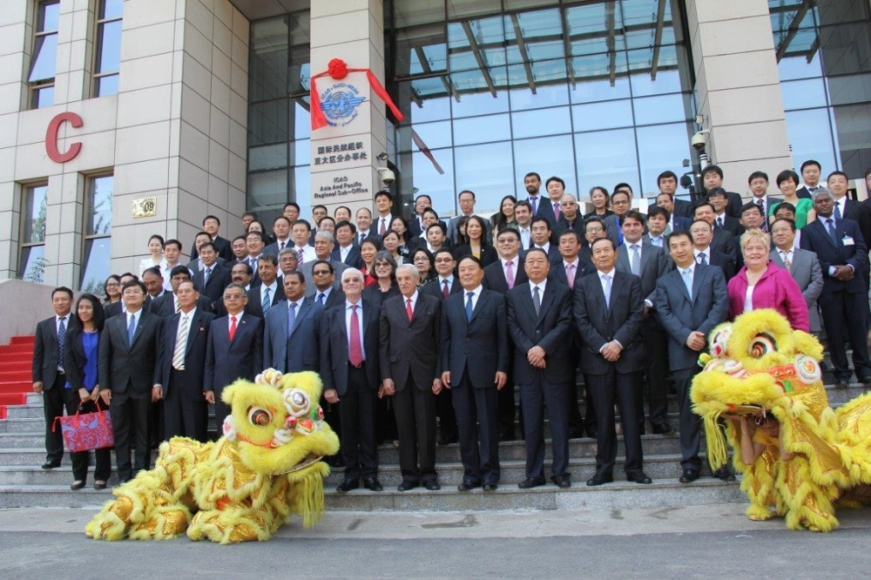
ICAO APAC Regional Sub-Office
ICAO Council agreed to establish a Regional Sub-Office (RSO) of the Asia Pacific (APAC) Office on 14 November 2011.
The RSO was inaugurated in Beijing, China on 27 June 2013.

Slide 3
RSO - Responsibilities
To improve airspace organization and maximize ATM performance and capability in Asia and Pacific.
Entrusted by ICAO Council to support States for implementation of efficient management of airspace and air traffic flow in the APAC Region through Airspace Organization and Management (AOM), Collaborative Decision Making (CDM), Air Traffic Flow Management (ATFM), Flexible Use of Airspace (FUA) and Performance-Based Navigation (PBN) aimed at meeting traffic growth.

Slide 4
Strategic Framework for the Regional Sub-Office (RSO)
}
Improve Safety and Efficiency of Flight Operations through Innovative Procedures.
B. Enhance Airspace Capacity and Efficiency to Accommodate Asian Aviation Growth
In coordination with ANB and APAC Regional Office
C. Optimize ATM Operations via Collaborative Management of Traffic Flow
}
D. Ensure Continuous Improvement of Organizational Performances
by Proper Managements of Quality, Work Plans, Resources and Developments of Team-members’ Capacity
Consistent with ICAO culture and practices

Slide 5
Regional Planning
Implementations
Feedback Capturing & Performance Monitoring and Reporting
Training & Sharing of Best Practices and Knowledge
RO as Main Player RSO as Supporting Player
RO as Supporting Player
RSO as Main Player
State Implementation Planning
Path Finding and Imp. Support
Note: Performance Monitoring and Reporting will be under the responsibility of the RO.

Slide 6
RSO Activities
Airspace Organization and Management (AOM) and Performance Based Navigation (PBN)
Terminal Area
Assisted Bangladesh, Fiji, Malaysia, Myanmar and Sri Lanka in effective airspace design using PBN for terminal airspace
Assisted Bangladesh, Cambodia, Fiji, Laos PDR, Malaysia, Maldives, Mongolia, Myanmar, Sri Lanka and Thailand in implementations and validations of PBN procedures in coordination with the APAC FPP
PBN Operational Approval
In cooperation with IATA, conducted trainings in PBN Operational Approval for regulators, airlines and ANSPs in Myanmar and Fiji
Provided assistances on PBN Operational Approval to Bhutan

Slide 7
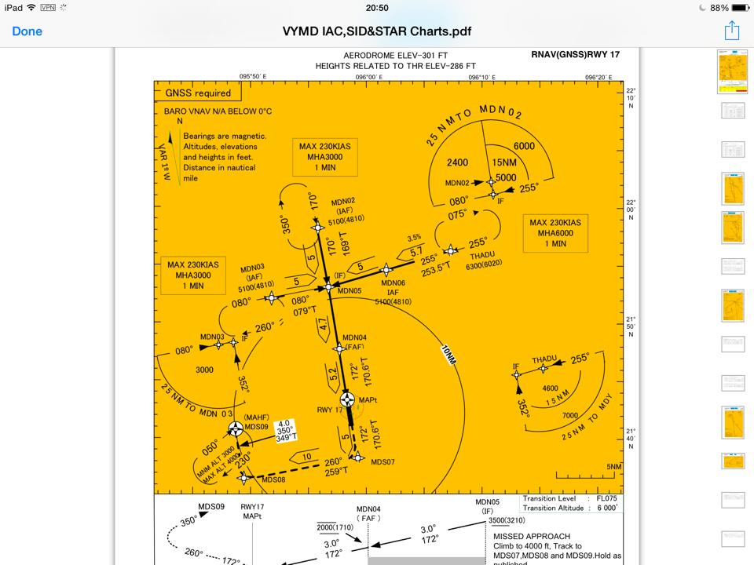
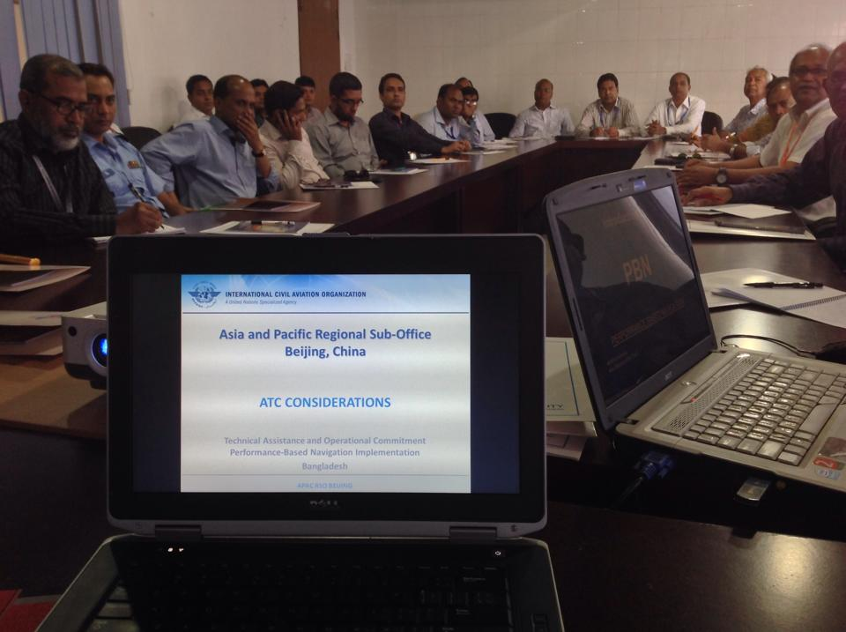
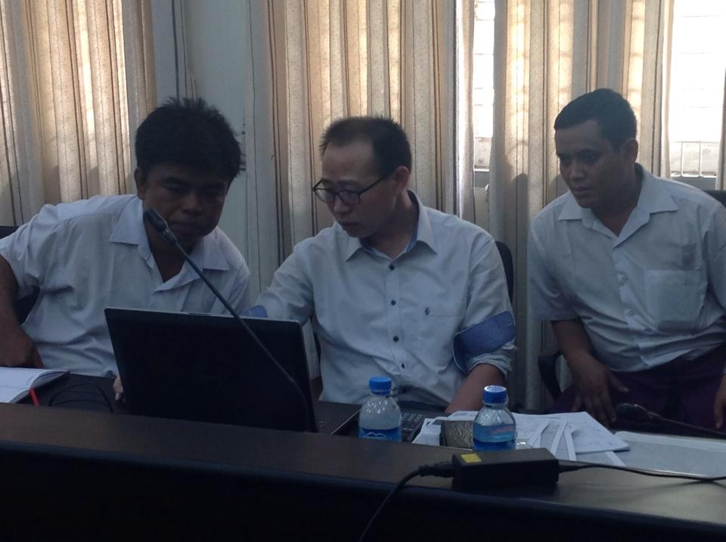
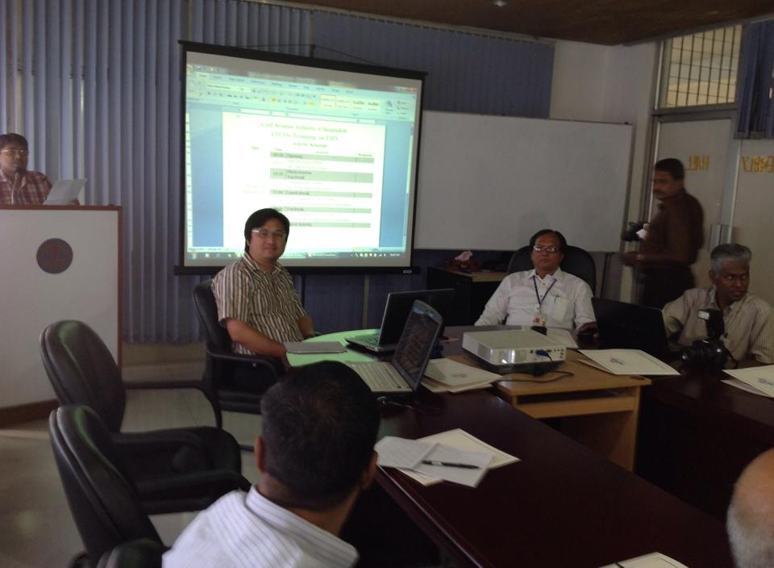

Slide 8
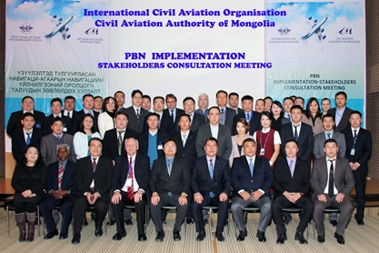
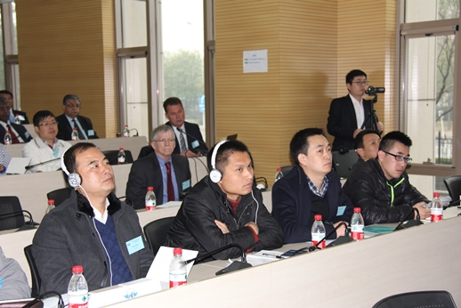
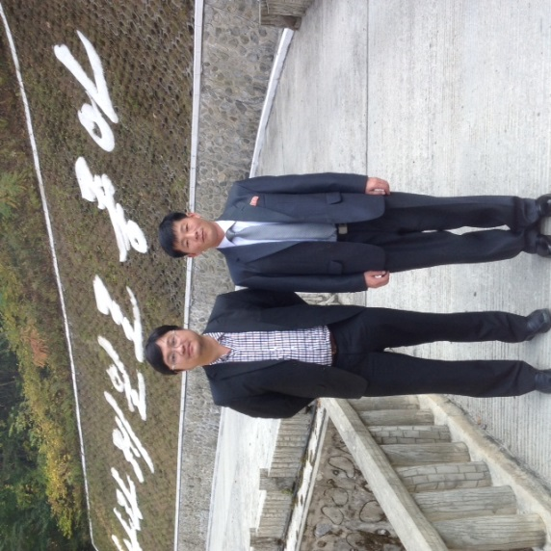

Slide 9
RSO Activities
Airspace Organization and Management (AOM) and Performance Based Navigation (PBN)
Airspace Optimization and Management
Facilitated the establishment and the conduct of APANPIRG PBN Implementation Coordination Group (PBNICG)
Supported ICAO/IATA/CANSO PBN Global Go-Team visits and PBN Airspace Design Workshops in Thailand and China
Conducted an Airspace Design Review for Fiji with participations from other Pacific Island States
Conducted a workshop on Civil Military Coordination and Flexible Use of Airspace for APAC States in Beijing, China
Entrusted by ICAO IFPP to develop PBN Procedure Construction Manual
Implementation Trainings
Conducted ATC training supporting PBN deployment in Bangladesh, Mongolia and Myanmar

Slide 10
RSO AOM and PBN Projects
MONGOLIA
Review of Route Structure
Review of PBN TMA Procedures
ATC Training
BHUTAN
PBN Ops Approval
BANGLADESH
PBN Review
Implementation Support
ATC Training
Airspace Design
CHINA
PBN Go-Team
CMAC/FUA Workshop
LAO PDR
Procedure Review
Cambodia
Review of PBN Implementation Plan
Bay of Bengal
Enhancement of PBN routes
PACIFIC ISLANDS:
Ops-Approval Course
Fiji: PBN OJT w/ FPP, Airspace Design, Implementation Support
[ATC Training]
MYANMAR
Ops Approval Course , Airspace Design, Implementation Support
ATC Training
MALAYSIA
Airspace Design
SRI LANKA
PBN OJT, Airspace Design, Implementation Support ATC Training
MALDIVES
Review of PBN Domestic Routes

Slide 11
RSO Activities
Airspace Organization and Management (AOM) and Performance Based Navigation (PBN)
Domestic and International En-route
Through a PBN Design Session, assisted Bangladesh, India, Myanmar and Thailand to their on-going review of international route structure and aircraft separation over Bay-of-Bengal
Through a PBN Design Session, supported Mongolia in the review and enhancement of international and domestic PBN route structure
Entrusted by States in Mekong sub-regions, including Cambodia, Lao PDR, Myanmar, Thailand, Vietnam, to facilitate international and domestic route structure reviews within the sub-region
Facilitated the first meeting of South China Sea Major Traffic Flow Review Group (SCS-MTFRG/1) in Malaysia

Slide 12
RSO Enroute Projects
Mongolia
Restructure Upper Airway
Bangladesh/India / Myanmar/ Thailand
PBN Routes
Mekong Delta
PBN Routes
DPR Korea
Exploratory Mission - PBN
Fiji
Realignment of Airways in conjunction with new PBN TMA design
Hong Kong / Philippines
Upgrade of Nav Specs / Realignment
South China Sea
Review of MTF & FLAS/FLOS
India/Maldives / Sri Lanka
PBN Unidirectional Routes

Slide 13
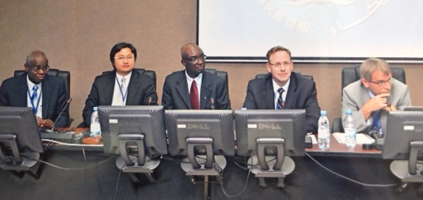
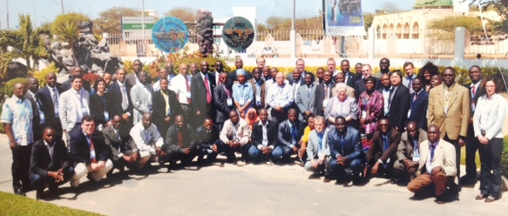
RSO Activities
Airspace Organization and Management (AOM) and Performance Based Navigation (PBN) Global and Regional Harmonization and Prioritization
In coordination with ICAO ANB and APAC RO, facilitated an establishment of the PBN Implementation Coordination Group under APANPIRG
Entrusted by ICAO IFPP to develop PBN Procedure Construction Manual
In coordination with ICAO ANB, assisted the establishment of Africa Flight Procedure Programme

Slide 14
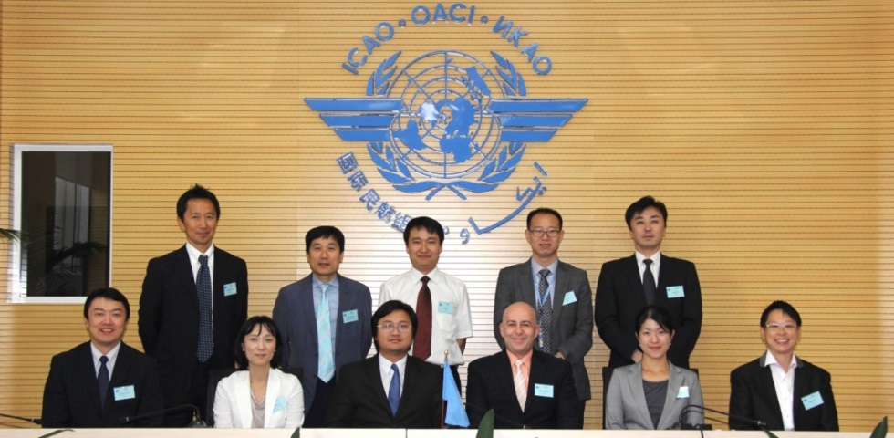
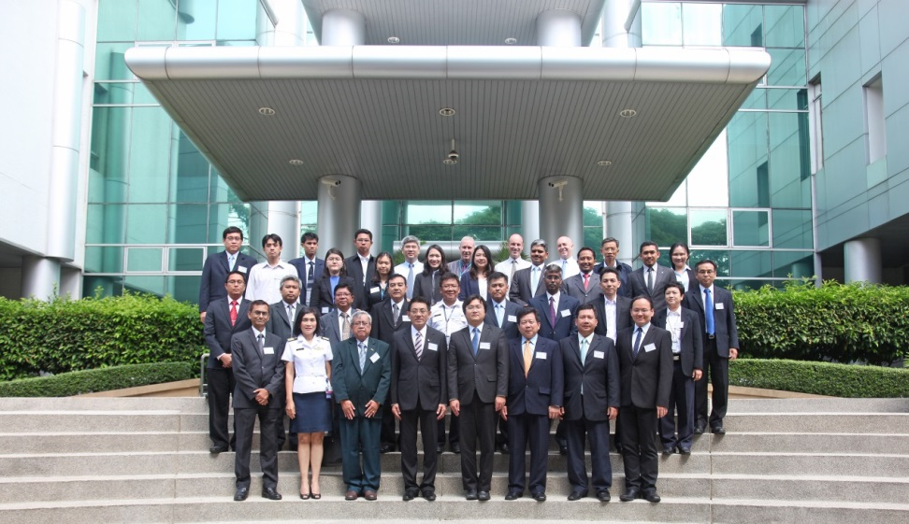
RSO Activities
ATFM/CDM
Regional Harmonization
Assisted China, Japan and ROK on the establishment of North-Asia Regional ATFM Harmonization Group (NARAHG).
Coordinated with ASEAN and Bangladesh, India, Myanmar, Thailand (BIMT) States on their on-going ATFM activities and initiatives

Slide 15
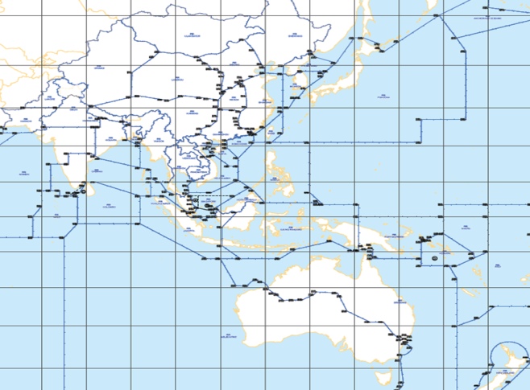
BIMT
Singapore
Thailand
Hong Kong
Malaysia
Singapore
Thailand
Hong Kong
Malaysia
+
Vietnam
Sanya, China
North East Asia
(China, ROK, Japan)
2013
2014
Australasia
Sub-Regional group
Sub-Regional ATFM
Harmonized Regional ATFM

Slide 16
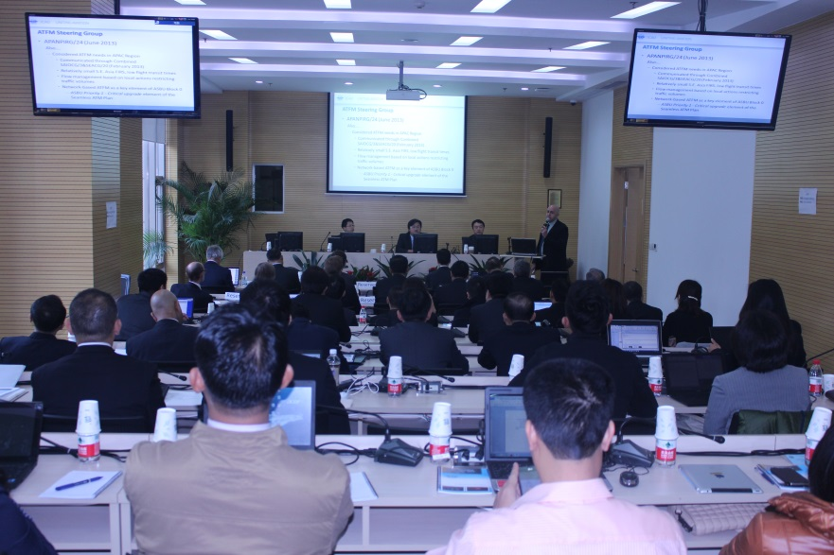
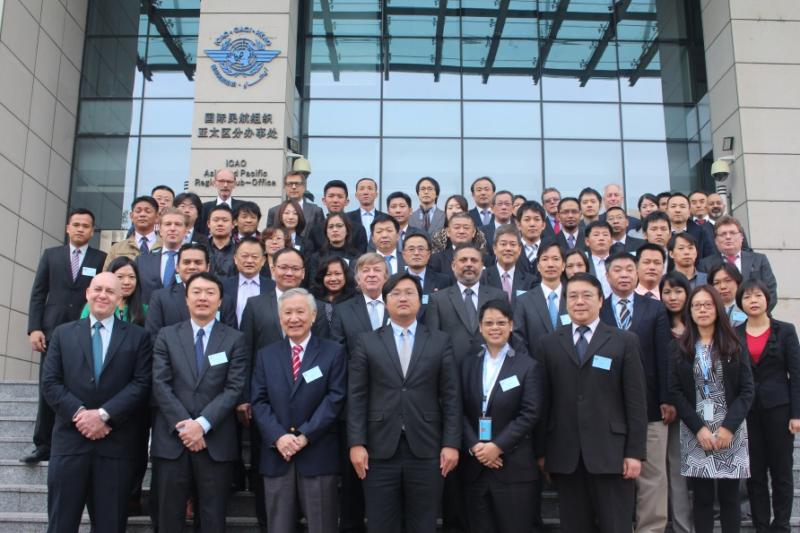
RSO Activities
ATFM/CDM
Conducted a project assessment for ATFM/CDM implementation project in Shanghai in coordination with CAA China
Conducted a briefing to China to gain better understanding of China’s plan for planning and implementation of ASBU, ATFM and CDM.
Conducted a trial course on Introduction to ATFM/CDM to IATA and its airline members
Conducted ATFM Workshop – Asia Pacific in October 2014 in Beijing, China
Conducted a Seminar on Basic Capacity Enhancement Concepts and Developments of ATFM for APAC States in Myanmar

Slide 17
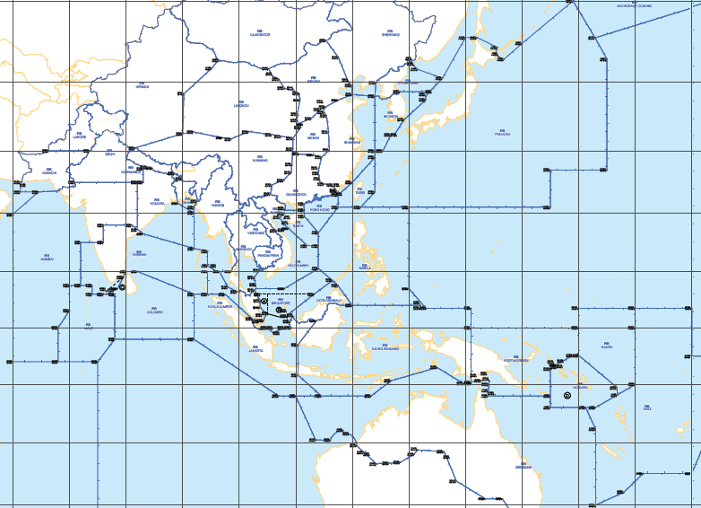
Coverage of RSO Projects

Slide 18
Contributions from States and International Organizations
Hosted by: China
Officers seconded from: China, Japan, Malaysia, Republic of Korea, Singapore and IATA
Financial/in-kind contributions received from:
China, DPRK, Fiji, Germany, India, Japan, Malaysia, Mongolia, Myanmar, Republic of Korea, Singapore, Thailand, the United States, ASEAN, IATA, CANSO, ACI and Eurocontrol

Slide 19
APAC FPP Training Schedule - 2015
Date | Activities | Location
9 Mar-3 April | Pans-Ops PD Initial Course | Beijing
11-29 May | PBN PD Course | Beijing
1-5 June (TBC) | PD Refresher Course 2015 (including all new amendments in Doc8168) | Beijing
6-10 July (TBC) | PD Quality Assurance Course | Beijing
13-17 July (TBC) | RNP AR Course | Beijing
3-21 August | PBN PD Course | Beijing
11-13 November | FPP SC 7 | Macau
Details and confirmations on all trainings may be found on APAC FPP web site www.fpp-icao.org .

Slide 20
RSO Cooperation with COSCAPs
PBN Implementation
Implementation Workshops
facilitate development of procedures and approval of operations;
provide technical advice to stakeholders in order that they can meet their obligations; and,
develop an action plan and timelines for initial implementation
Conducted 15 times in Indonesia, Brunei, Sri Lanka, Nepal, Mongolia, Myanmar, Laos PDR, Vietnam, Bangladesh, the Philippines, Republic of Korea, Pakistan, Maldives, Cambodia and Malaysia
Safety Assessment and Stakeholder Consultation
Mongolia – Safety Assessment and Stakeholder Consultation for enhanced enroute and terminal area structure, including RNP APCH and PBN Routes

Slide 21
Outcomes & Accomplishments – COSCAP NA Members

